Slide 1

Spam Detection Using Machine Learning
AI680-CS666-001_BK_FALL2025_GROUP 6
BY:
Naisargi Sharma (100868470)
Vandan Patel (100865552)
Yash Sanklecha (100816558)

Slide 2
Outlines
Project Overview
Real-world Applications
Literature Review and Results
Algorithm Approach
Understanding the Functions
Obtained Results
Conclusion
Summary of References
Connection Between the Literature (Paper-3) and Our Model
Model Comparison (Summary Plot)
Error Analysis
Real-World Deployment

Slide 3

Project Overview
In today’s digital age, spam emails are a pervasive issue, affecting both individuals and businesses. Spam emails not only disrupt communication but also pose significant security threats, such as phishing, malware, and identity theft. Detecting and filtering out these unwanted emails is crucial for improving productivity, security, and the overall email experience.

Slide 4

Objective of the Project:
The goal of this project is to develop an automated spam email classification system using machine learning models. The system will classify emails as spam or ham (non-spam) based on their content, helping users and organizations to filter out unwanted messages.

Slide 5
APPLICATION
Email Filtering – Clean & Safe Inbox:
Spam-Free Inbox: Automatically filters out unwanted emails like ads and scams.
Security First: Protects from malicious links and attachments.
Efficient Communication: Keeps your inbox clutter-free and only relevant emails get through.
Adaptive Classification: Learns to stay ahead of evolving spam threats.
Messaging Apps – Smarter Communication:
Unwanted Message Blocker: Stops spammy or promotional messages.
Phishing Protection: Safeguards personal info from deceptive messages.
AI-Powered Filters: Blocks unknown contacts or numbers for added privacy.
Cybersecurity – Fortifying Your Digital World:
Phishing Defense: Stops fraudsters from stealing sensitive data.
Malware Protection: Prevents virus and ransomware spread.
Data Breach Prevention: Protects against attacks that could compromise your data.
Secure Messaging: Ensures encrypted and safe communication.

Slide 6
Literature Review
Paper 1: Exploring the Current State of Machine Learning in Spam Detection:
Paper 2:Email Spam: A Comprehensive Review of Optimize Detection Methods, Challenges, and Open Research Problems:
Paper 3: A Stacking Approach: Machine Learning for Spam Email

Slide 7
LITERATURE REVIEW RESULTS
Paper-1 Exploring the Current State of Machine Learning in Spam Filters (2025): It discusses how traditional spam detection methods such as rule-based, Bayesian, and IP-based filtering struggle to keep up with modern spam tactics. It highlights that classical machine learning models combined with TF-IDF representations still deliver strong baseline performance for both SMS and email spam classification, especially under limited computational resources. The study emphasizes that hybrid and ensemble models outperform single algorithms when spam strategies evolve, and that regular model retraining is crucial to handle concept drift. Overall, it demonstrates that machine learning not only improves adaptability but also provides a practical and scalable foundation for intelligent spam defense systems.
Paper-2: Email Spam: A Comprehensive Review of Optimize Detection Methods, Challenges, Open Research Problems (2024), It provides an extensive review of machine learning, deep learning, and fuzzy logic approaches for spam detection. It shows that hybrid and ensemble techniques — and even lightweight deep learning models such as LSTM and BERT — can achieve very high accuracy when paired with rich features and proper preprocessing. The study also points out that spam datasets are often imbalanced, so metrics like Precision-Recall AUC and F1-score should be prioritized over accuracy. Moreover, it identifies research gaps such as the need for adversarial robustness, efficient handling of evolving spam patterns, and low-latency performance in real-time systems. The paper concludes by recommending the use of adaptive pipelines that continuously monitor and retrain models to maintain effectiveness in dynamic environments.
Paper-3 Improving the Accuracy of Cybersecurity Spam Email Detection Using Ensemble Techniques: A Stacking Approach (2025), It proposes an advanced stacking ensemble framework that combines Naive Bayes, k-Nearest Neighbors, Logistic Regression, and XGBoost under a meta-learner. By using grid search and cross-validation, the authors optimized hyperparameters to achieve an impressive accuracy of 99.79%, along with high precision and recall. The model also reduced false positives compared to standalone classifiers, making it suitable for real-world deployment. This study demonstrates that ensemble learning significantly enhances robustness and generalization while maintaining high detection performance. It also suggests that future improvements should focus on computational efficiency and integrating smarter sampling techniques like SMOTE or cost-sensitive learning to handle class imbalance.

Slide 8
Connection Between the Literature (Paper-3) and Our Model
Paper-3 Overview (Stacking Ensemble Approach):
Base Models: Logistic Regression, SVM, Random Forest, etc.
Meta Learner: Logistic Regression.
Stacking Methodology: Aimed to enhance model performance by combining base model predictions into a final, more robust decision.
How We Adapted Paper-3's Approach:
Base Learners: We used Logistic Regression (LR) and Support Vector Machine (SVM), as suggested in Paper-3, due to their effectiveness in binary classification tasks.
Meta Learner: Logistic Regression was used to combine the outputs of LR and SVM, following Paper-3’s findings that this combination improves accuracy.
Insights Applied from Paper-3:
Diversity in Base Models: LR and SVM were chosen to capture different decision boundaries.
Performance Gains: Our stacking ensemble, like Paper-3, improves upon individual models.

Slide 9
ALGORITHM/APPROACH/METHODOLOGY
Data Collection
A labeled dataset of emails or messages, categorized as Spam or Ham (non-spam).
Data Preprocessing
Cleaning the raw text data to prepare it for model training.
Feature Extraction
Convert the cleaned text data into numerical features that can be fed into machine learning models.
Model Selection and Training
Trained different machine learning models to classify messages as spam or ham.
Model Evolution
Evaluate the trained models on unseen test data to assess their performance.

Slide 10
UNDERSTANDING THE FUNCTIONS
1. Data Collection:
Email Dataset: Collect a large set of labeled emails (spam vs ham) to train the model.
Features: Raw email text, which serves as the input for classification models.
2. Pre-processing and Feature Extraction:
Text Cleaning: Removes noise (e.g., special characters, stop words) to standardize the data.
TF-IDF Vectorization: Converts email text into numerical features, capturing important word patterns and their significance.
3. Classification Models:
Support Vector Machine (SVM): A powerful algorithm that separates spam from ham emails by finding the best decision boundary.
Logistic Regression: A linear model used to predict the probability of an email being spam or ham.
Stacking Ensemble: Combines multiple models (SVM + Logistic Regression) to improve accuracy by leveraging the strengths of each model.
4. Model Training:
Learning Patterns: The models are trained on the pre-processed data to recognize spam and ham patterns.
Optimization: Hyperparameters are fine-tuned to improve model performance.
5. Evaluation:
Performance Metrics: The models are evaluated using accuracy, precision, recall, F1-score
Error Analysis: Identifies mistakes (false positives and false negatives) to understand model limitations and guide improvements.

Slide 11
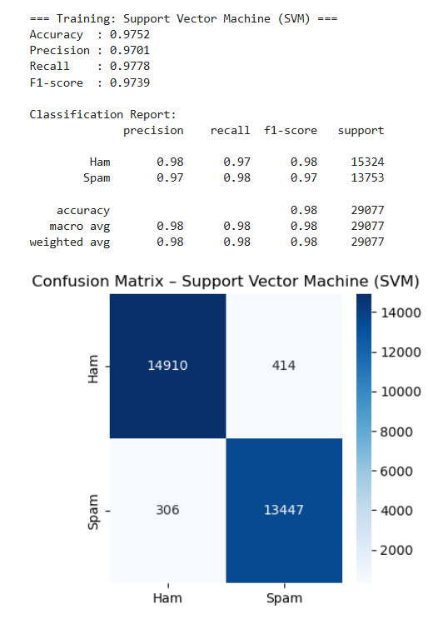
OBTAINED RESULTS
Support Vector Machine (SVM):
Purpose: A powerful classifier that seeks the optimal hyperplane that separates spam and ham emails with the largest possible margin.
How It Works:
SVM works by transforming the data into a higher-dimensional space (if necessary) and then finding a hyperplane (decision boundary) that best divides the classes.
It maximizes the margin between the nearest points (called support vectors) of each class, making it robust to overfitting in high-dimensional spaces.
Advantages:
Handles non-linear data well using kernel tricks.
Effective in high-dimensional spaces (ideal for text data with many features).
Limitations:
Memory Intensive: May struggle with very large datasets or noisy data.
No direct probability outputs (unless using a probability-calibrated SVM, which can be computationally expensive).

Slide 12
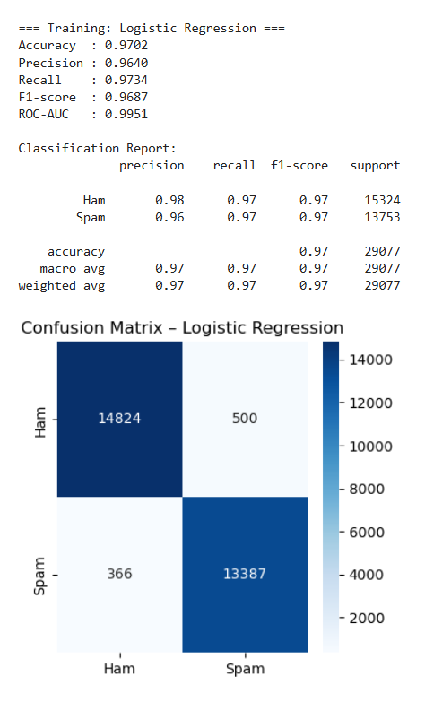
Logistic Regression:
Purpose:
A linear model that predicts the probability of an email being spam or ham based on the relationship between the input features and the log-odds of the outcome.
How It Works:
It uses the sigmoid function to map the output of a linear equation to a probability between 0 and 1.
The logistic regression model tries to find the best coefficients (weights) for each feature (word or term) so that the linear combination of features leads to the correct classification.
Advantages:
Simple & Interpretable: Easily interpretable, where the weights of features give insights into which words contribute to classification.
Efficient: Requires less computational power and can handle large datasets.
Limitations:
Linear Assumption: Assumes a linear relationship between features, which may not capture complex patterns (e.g., interactions between words in spam/ham classification).

Slide 13
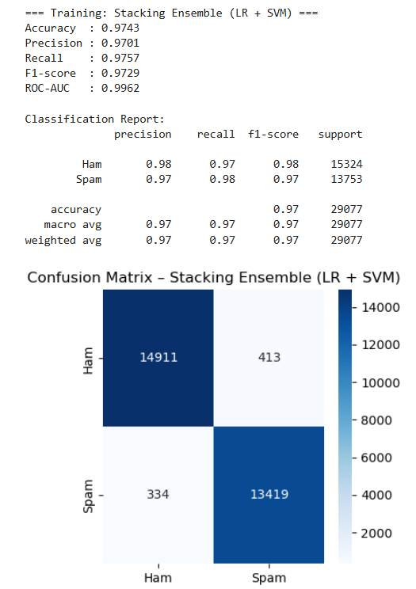
Stacking Ensemble:
Purpose:
Combines the predictions from multiple base models (e.g., SVM and Logistic Regression) to create a stronger, more accurate model.
How It Works:
The base learners (SVM and Logistic Regression) make predictions independently.
The meta-learner (often a simpler model like Logistic Regression) is trained to combine the predictions of the base models and produce the final classification.
This method leverages the strengths of different algorithms to improve the overall prediction accuracy.
Advantages:
Improved Accuracy: Stacking often outperforms individual models because it combines the best aspects of multiple models.
Flexibility: Works well with various types of models, both linear and non-linear.
Limitations:
Complexity: Requires more computation and training time due to multiple models.
Risk of Overfitting: If not properly tuned, stacking can overfit the training data, especially with weak base learners.

Slide 14
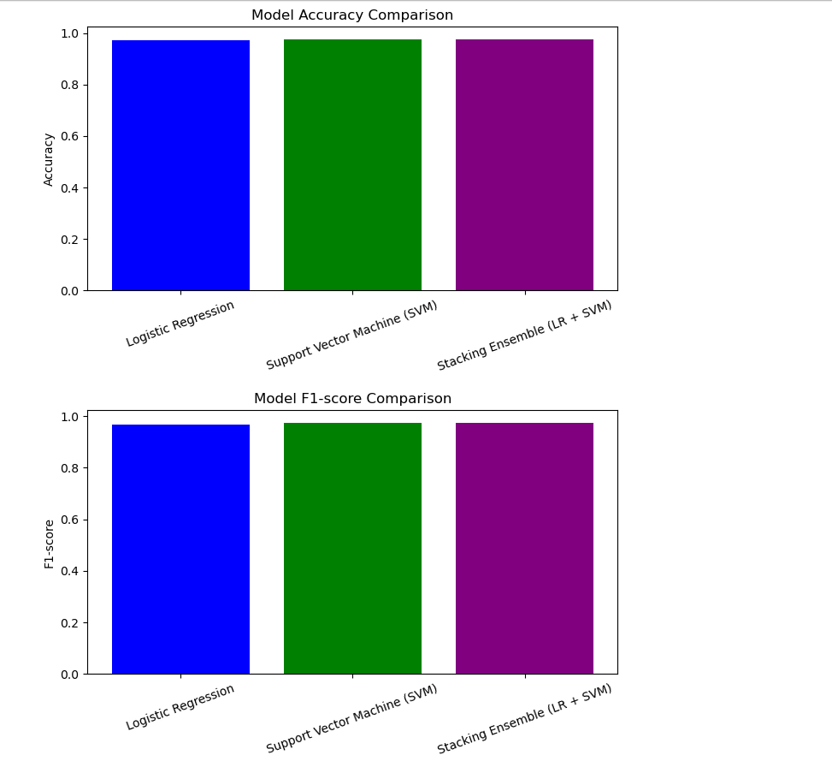
Model Comparison (Summary Plot)
Comparison of Performance Metrics:
Logistic Regression (LR)
Support Vector Machine (SVM)
Stacking Ensemble (LR + SVM)
The models were assessed using the following evaluation metrics:
Accuracy – Overall correctness of predictions.
Precision – Accuracy of positive predictions (Spam).
Recall – Ability to identify actual Spam emails.
F1-Score – Balance between Precision and Recall.
ROC-AUC – Ability to distinguish between Spam and Ham.

Slide 15
Error Analysis
Where Models Struggled:
False Positives (FP):
Legitimate marketing emails flagged as spam (e.g., newsletters).
False Negatives (FN):
Malicious emails classified as ham (e.g., phishing emails).
Improvements:
Feature Expansion:
Include email metadata (e.g., sender, subject) or semantic embeddings using models like BERT.
SMOTE (Synthetic Minority Over-sampling Technique):
Address class imbalance by augmenting the spam class in the training set.

Slide 16
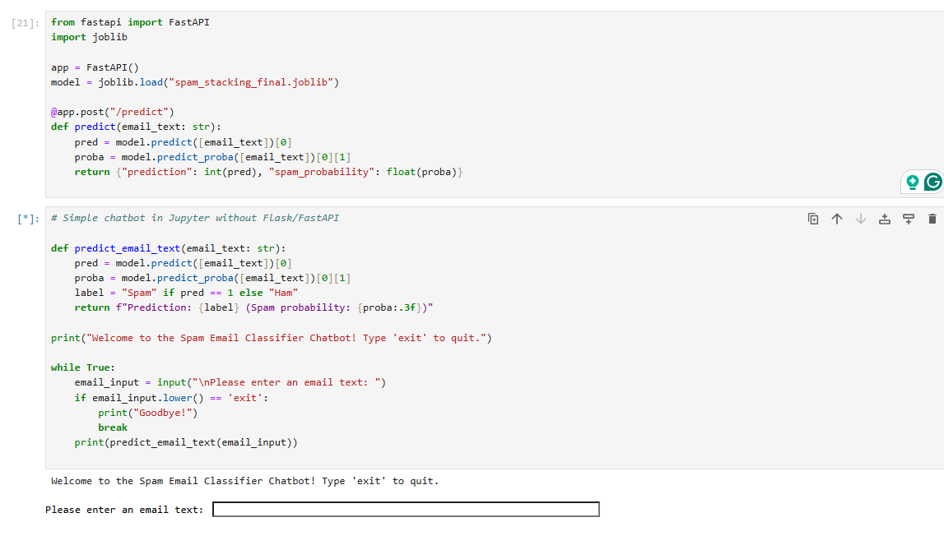
Real-World Deployment
Model Saving & API Deployment:
Save the trained stacking model (joblib).
Expose the model via FastAPI or Flask for real-time email classification.
Predicting New Emails:
Emails can be automatically classified by the model when they arrive.
Results: Spam or Ham, with confidence score (probability).
Integration with Email Servers:
Use the classification results to filter spam emails into dedicated folders.
Monitoring & Updating:
Periodic Retraining: Ensure the model adapts to evolving spam strategies.
Implement drift detection to monitor and retrain when performance drops.

Slide 17
CONCLUSION
Our project showed that machine learning is highly effective for spam detection using the 190K Kaggle email dataset. Logistic Regression and SVM both performed very well, achieving over 97% accuracy with strong precision and recall. SVM captured the most spam messages with the lowest false negatives, while Logistic Regression provided stable and consistent results. However, the Stacking Ensemble, which combines LR and SVM, delivered the most balanced and reliable performance overall. It reduced both false positives and false negatives and achieved the highest AUC score, showing excellent separation between spam and ham. This is why we chose the stacking approach—because it combines the strengths of both models and makes the system more accurate, robust, and suitable for real-world email filtering.
Conclusion

Slide 18
REFERENCES
Tusher, E. H., Ismail, M. A., Rahman, M. A., Alenezi, A. H., & Uddin, M. (2024). *Email spam: A comprehensive review of optimized detection methods, challenges, and open research problems*. *IEEE Access*, 12, 143627–143657. [https://doi.org/10.1109/ACCESS.2024.3467996](https://doi.org/10.1109/ACCESS.2024.3467996)
Saleh, A. J., Alshahri, M., & Elmas, A. (2019). *An intelligent spam detection model based on artificial immune system and machine learning for email classification*. *Information*, 10(6), 209. [https://doi.org/10.3390/info10060209](https://doi.org/10.3390/info10060209)
Dada, E. G., Bassi, J. S., Chiroma, H., Abdulhamid, S. M., Adetunmbi, A. O., & Ajibuwa, O. E. (2019). *Machine learning for email spam filtering: Review, approaches and open research problems*. *Heliyon*, 5(6), e01802. [https://doi.org/10.1016/j.heliyon.2019.e01802](https://doi.org/10.1016/j.heliyon.2019.e01802)
Tian, Y., et al. (2025). *A stacking approach: Machine learning for spam email detection*. *Journal of Applied Sciences and Engineering*, 2025(4), 137–150. [https://doi.org/10.5220/0013701900004196](https://doi.org/10.5220/0013701900004196)
Maram, S. C. R. (2021). *SMS spam and ham detection using Naïve Bayes algorithm*. SSRN. [https://papers.ssrn.com/sol3/papers.cfm?abstract_id=3908998](https://papers.ssrn.com/sol3/papers.cfm?abstract_id=3908998)6. Shirvani, G., & Ghasemshirazi, S. (2025). *Advancing email spam detection: Leveraging zero‑shot learning and large language models*. arXiv. [https://arxiv.org/abs/2505.02362](https://arxiv.org/abs/2505.02362)

Slide 19
Questions

